Slide 1
Governance Committee Survey, Fall 2019

Slide 2
Co-Chairs:
Dr. Mickey Latour, College of Agricultural Sciences
Jay Needham, MFA, College of Mass Communications and Media Arts
Members:
Dr. Jerry Becker, College of Education and Human Services
Dr. Scott Comparato, College of Liberal Arts
Dr. Heeyoung Han, SIUC School of Medicine
Dr. Laura Halliday, College of Liberal Arts
Dr. Shane Koch, College of Education and Human Services
Dr. Hee-Seung Lee, College of Applied Sciences
Dr. Christopher McDowell, SIUC School of Medicine
Dr Robin Warne, College of Science
Governance Committee

Slide 3
Purpose
1. To determine what are the major concerns on-campus.
2. To determine a priority list/rank order of concerns.
3. To host a Town Hall meeting to discuss findings and seek input.

Slide 4
Layout of Survey
Across TT/NTT and Carbondale/Springfield campuses

Slide 5
These questions/concerns were developed from soliciting input
from members and organized into a 5-point survey.
The morale of faculty is a problem the University
2. I understand the vision for our university’s future
3. I trust administration to provide honest information to faculty
4. Administrative instability is a problem for the university
5. I am certain that decreasing enrollment threatens our university
6. I am confident that the administration supports shared governance
There are well-articulated outcomes for the reorganization process Other (fill in a word or phase)

Slide 6
Which of these is a major issue for faculty? Scoring is on a 5-point scale to estimate level of agreement on issues.
5= strongly agree
4= agree
3= neutral
2= disagree
1= strongly disagree

Slide 7
Data/Results

Slide 8
1 - You identify as:
# | Answer | % | Count
1 | Tenure/tenure track | 66.77% | 223
2 | NTT | 33.23% | 111
 | Total | 100% | 334
Sent to 1371 individuals
334/1371 *100 = 24%

Slide 9
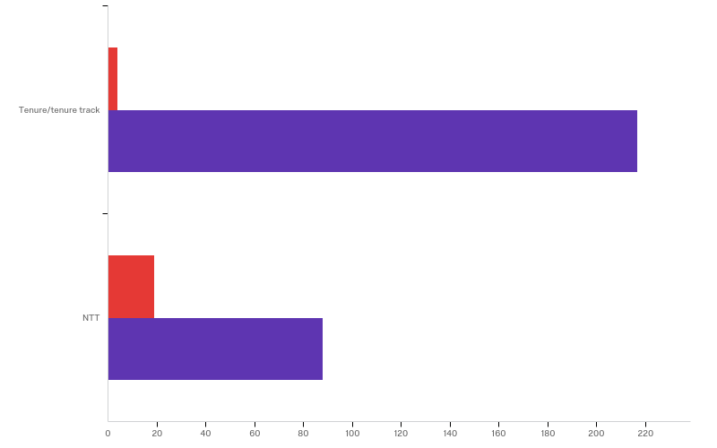
2 - You reside on which campus?

Slide 10
Rating of the Questions Which of these is a major issue for faculty? Scoring is on a 5-point scale to estimate level of agreement on issues.
5= strongly agree
4= agree
3= neutral
2= disagree
1= strongly disagree

Slide 11
Tenure/tenure track
# | Field | Mean
5 | I am certain that decreasing enrollment threatens our university | 4.44
1 | The morale of faculty is a problem the University | 4.39
4 | Administrative instability is a problem for the university | 4.31
3 | I trust administration to provide honest information to faculty | 2.30
6 | I am confident that the administration supports shared governance | 2.28
2 | I understand the vision for our university’s future | 2.05
7 | There are well-articulated outcomes for the reorganization process | 1.80
Strongly Agree/
Agree
Strongly Disagree/ Disagree

Slide 12
Non Tenure Track
#S | Field | Mean
5 | I am certain that decreasing enrollment threatens our university | 4.22
4 | Administrative instability is a problem for the university | 3.97
1 | The morale of faculty is a problem the University | 3.64
3 | I trust administration to provide honest information to faculty | 2.92
6 | I am confident that the administration supports shared governance | 2.80
2 | I understand the vision for our university’s future | 2.74
7 | There are well-articulated outcomes for the reorganization process | 2.42
Strongly Agree/Agree
Neutral
Disagree

Slide 13
Degree which each group (TT/NTT) rated questions

Slide 14
The morale of faculty is a problem the University
# | Question | Tenure/tenure track | NTT
5 | strongly agree | 84.42% | 15.58%
I understand the vision for our university’s future
# | Question | Tenure/tenure track | NTT
1 | strongly disagree | 81.90% | 18.10%
v
I trust administration to provide honest information to faculty
# | Question | Tenure/tenure track | NTT
1 | strongly disagree | 80.00% | 20.00%
Administrative instability is a problem for the university
# | Question | Tenure/tenure track | NTT
5 | strongly agree | 76.16% | 23.84%
I am certain that decreasing enrollment threatens our university
# | Question | Tenure/tenure track | NTT
5 | strongly agree | 72.77% | 27.23%

Slide 15
I am confident that the administration supports shared governance
# | Question | Tenure/tenure track | NTT
1 | strongly disagree | 81.82% | 18.18%
There are well-articulated outcomes for the reorganization process
# | Question | Tenure/tenure track | NTT
1 | strongly disagree | 84.67% | 15.33%

Slide 16
Rankings of Importance
Combined Agreement between
TT/NTT

Slide 17
Tenure/tenure track
# | Field | Mean
5 | Enrollment | 2.64
2 | Vision for the university | 3.80
1 | Morale | 3.89
3 | Reorganization | 4.81
4 | Shared Governance | 4.42
6 | Administrative Instability | 4.18
7 | Trust | 4.17
NTT
# | Field | Mean
5 | Enrollment | 2.88
2 | Vision for the university | 3.82
6 | Administrative Instability | 3.82
7 | Trust | 3.87
1 | Morale | 4.39
3 | Reorganization | 4.36
4 | Shared Governance | 4.63

Slide 18
One word fill in or phrase

Slide 19
Captured Other (TT)
Salary
Communication
Captured Other (NTT)
Salary
Communication

Slide 20
Summary Points
Items | Tenure Track | NTT
Agreement within Questions | Clear trends | Distributed across possibilities
Ranking the issues | Enrollment Vision for University | Enrollment Vision for University
Other issues | Communication Salary | Communication Salary

Slide 21
Moving to Jennifer Fuller

Slide 22
Final Thoughts and Open for Questions/Input
Enrollment:
  STRONG AGREEMENT OVER ENROLLMENT (TT/NTT)
2. Vision:
  STRONG AGREEMENT OVER VISION (TT/NTT)
3. Communication:
  STRONG AGREEMENT OVER IMPROVING COMMUNICATION:
4. Salary:
  Noted as important, but this is a bargaining/contract item and being handled by our individual bargaining units.

